Slide 1
Business Statistics:
A First Course
(3rd Edition)
Chapter 4
Basic Probability

Slide 2
Chapter Topics
Basic Probability Concepts
  Sample spaces and events, simple probability, joint probability
Conditional Probability
  Statistical independence, marginal probability

Slide 3

Sample Spaces
Collection of All Possible Outcomes
  e.g. All 6 faces of a die:
  e.g. All 52 cards of a bridge deck:

Slide 4
Events
Simple Event
  Outcome from a sample space with 1 characteristic
  e.g. A Red Card from a deck of cards
Joint Event
  Involves 2 outcomes simultaneously
  e.g. An Ace which is also a Red Card from a deck of cards

Slide 5
Visualizing Events
Contingency Tables
Tree Diagrams
Ace Not Ace Total
Black 2 24 26
Red 2 24 26
Total 4 48 52
Ace
Red
Cards
Full
Deck
of Cards
Not an Ace
Black
Cards
Ace
Not an Ace

Slide 6





Simple Events
The Event of a Happy Face
There are 5 happy faces in this collection of 18 objects

Slide 7
Joint Events
The Event of a Happy Face AND Yellow
1 Happy Face which is Yellow

Slide 8
Special Events
Impossible Event
Impossible Event
  Impossible event
  e.g. Club & Diamond on 1 card
  draw
Complement of Event
  For event A, all events not in A
  Denoted as A’
  e.g. A: Queen of Diamond
  A’: All cards in a deck that are not Queen of
  Diamond
♣
♣

Slide 9
Special Events
(continued)
Mutually Exclusive Events
  Two events cannot occur together
  e.g. A: Queen of Diamond; B: Queen of Club
    Events A and B are mutually exclusive
Collectively Exhaustive Events
  One of the events must occur
  The set of events covers the whole sample space
  e.g. A: All the Aces; B: All the Black Cards; C: All the Diamonds; D: All the Hearts
    Events A, B, C and D are collectively exhaustive
    Events B, C and D are also collectively exhaustive

Slide 10
Contingency Table
A Deck of 52 Cards
Red Ace
Ace
Not an
Ace
Total
Red
2
24
26
Black
2
24
26
Total
4
48
52
Sample Space

Slide 11

Tree Diagram
Event Possibilities
Ace
Red
Cards
Not an Ace
Full
Deck
of Cards
Ace
Black
Cards
Not an Ace

Slide 12
Probability
Probability is the Numerical
Measure of the Likelihood
that an Event Will Occur
Value is Between 0 and 1
Sum of the Probabilities of
all Mutually Exclusive and
Collective Exhaustive Events
is 1
1
Certain
.5
0
Impossible

Slide 13
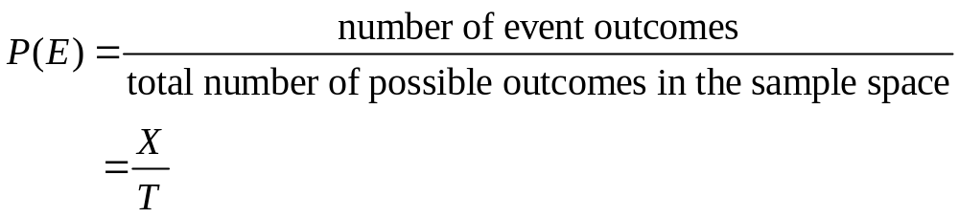

Computing Probabilities
The Probability of an Event E:
Each of the Outcomes in the Sample Space is Equally Likely to Occur
e.g. P( ) = 2/36
(There are 2 ways to get one 6 and the other 4)

Slide 14
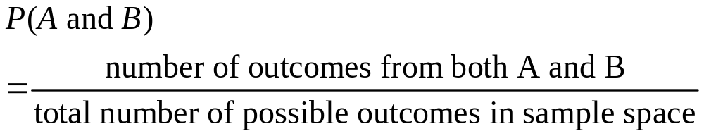
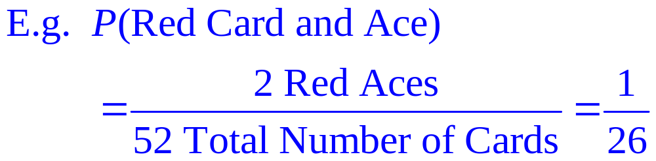
Computing Joint Probability
The Probability of a Joint Event, A and B:

Slide 15
Joint Probability Using Contingency Table
Event
Event
B₁
B₂
Total
A₁
P(A₁ and B₁)
P(A₁ and B₂)
P(A₁)
A₂
P(A₂ and B₁)
P(A₂ and B₂)
P(A₂)
Total
P(B₁)
P(B₂)
1
Joint Probability
Marginal (Simple) Probability

Slide 16
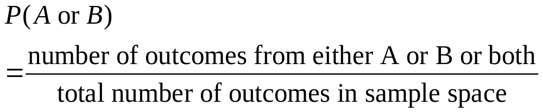
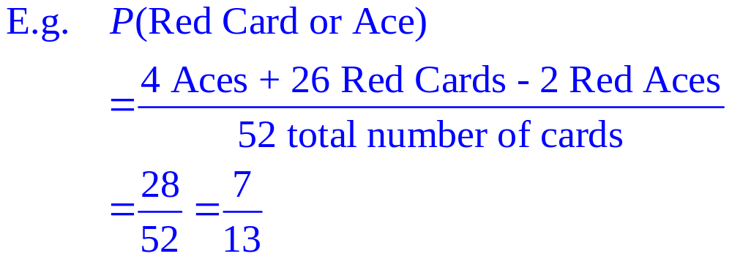
Computing Compound Probability
Probability of a Compound Event, A or B:

Slide 17
Compound Probability
(Addition Rule)
P(A₁ or B₁ ) = P(A₁) + P(B₁) - P(A₁ and B₁)
Event
Event
B₁
B₂
Total
A₁
P(A₁ and B₁)
P(A₁ and B₂)
P(A₁)
A₂
P(A₂ and B₁)
P(A₂ and B₂)
P(A₂)
Total
P(B₁)
P(B₂)
1
For Mutually Exclusive Events: P(A or B) = P(A) + P(B)

Slide 18
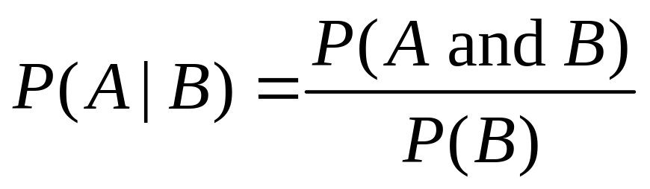
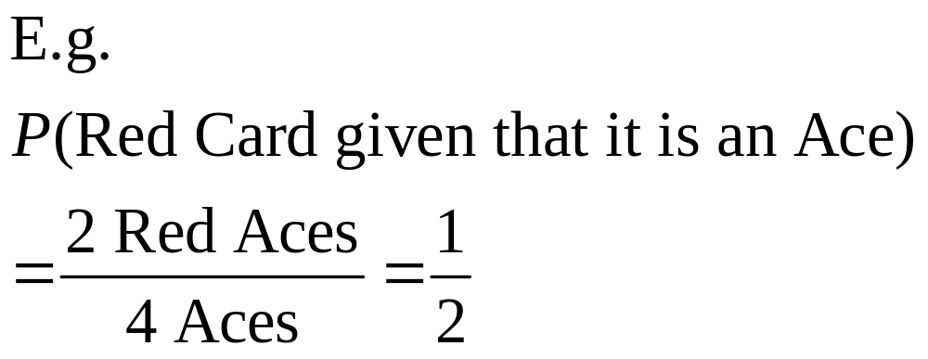
Computing Conditional Probability
The Probability of Event A given that Event B Has Occurred:

Slide 19
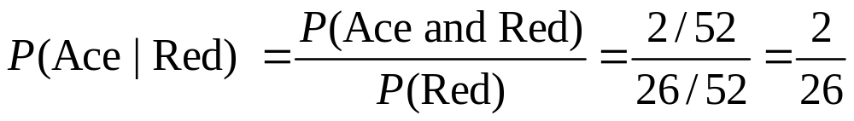
Conditional Probability Using Contingency Table
Color
Type
Red
Black
Total
Ace
2
2
4
Non-Ace
24
24
48
Total
26
26
52
Revised Sample Space

Slide 20
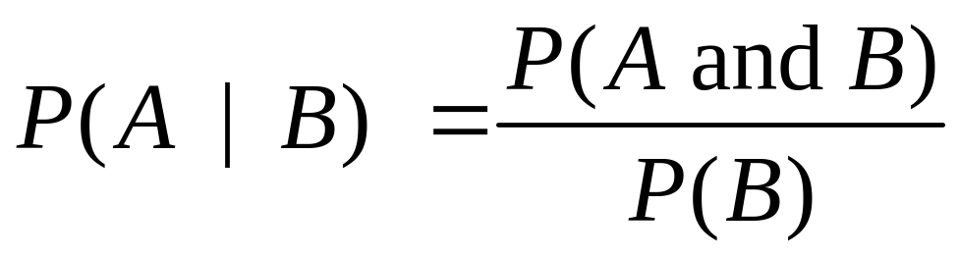
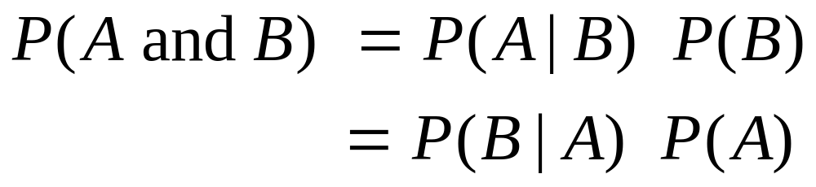
Conditional Probability and Statistical Independence
Conditional Probability:
Multiplication Rule:

Slide 21
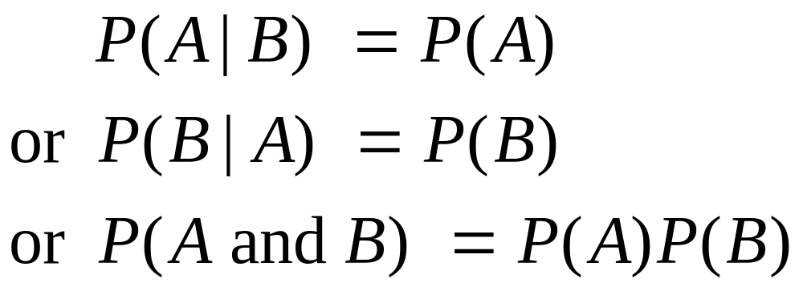
Conditional Probability and Statistical Independence
(continued)
Events A and B are Independent if
Events A and B are Independent when the Probability of One Event, A, is Not Affected by Another Event, B

Slide 22
Chapter Summary
Discussed Basic Probability Concepts
  Sample spaces and events, simple probability, and joint probability
Defined Conditional Probability
  Statistical independence, marginal probability

